Slide 1

CHAPTER 9
COUNTING AND
PROBABILITY
Copyright © Cengage Learning. All rights reserved.

Slide 2
SECTION 9.6
r-Combinations with Repetition Allowed
Copyright © Cengage Learning. All rights reserved.

Slide 3
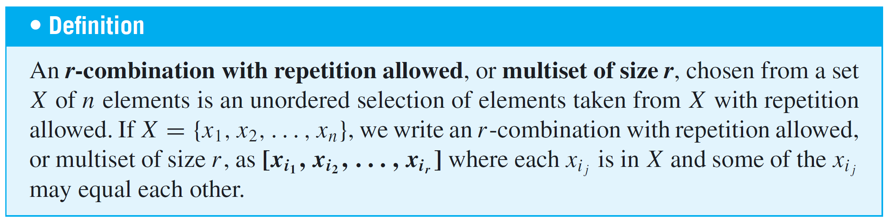
r-Combinations with Repetition Allowed
In this section we ask: How many ways are there to choose r elements without regard to order from a set of n elements if repetition is allowed ? A good way to imagine this is to visualize the n elements as categories of objects from which multiple selections may be made.

Slide 4


Example 1 – r-Combinations with Repetition Allowed
Write a complete list to find the number of 3-combinations with repetition allowed, or multisets of size 3, that can be selected from {1, 2, 3, 4}. Observe that because the order in which the elements are chosen does not matter, the elements of each selection may be written in increasing order, and writing the elements in increasing order will ensure that no combinations are overlooked.
Solution:

Slide 5


Example 1 – Solution
cont’d
Thus there are twenty 3-combinations with repetition allowed.

Slide 6
r-Combinations with Repetition Allowed
To count the number of r-combinations with repetition allowed, or multisets of size r, that can be selected from a set of n elements, think of the elements of the set as categories.
Then each r-combination with repetition allowed can be represented as a string of n – 1 vertical bars (to separate the n categories) and r crosses (to represent the r elements to be chosen).
The number of ×’s in each category represents the number of times the element represented by that category is repeated.

Slide 7
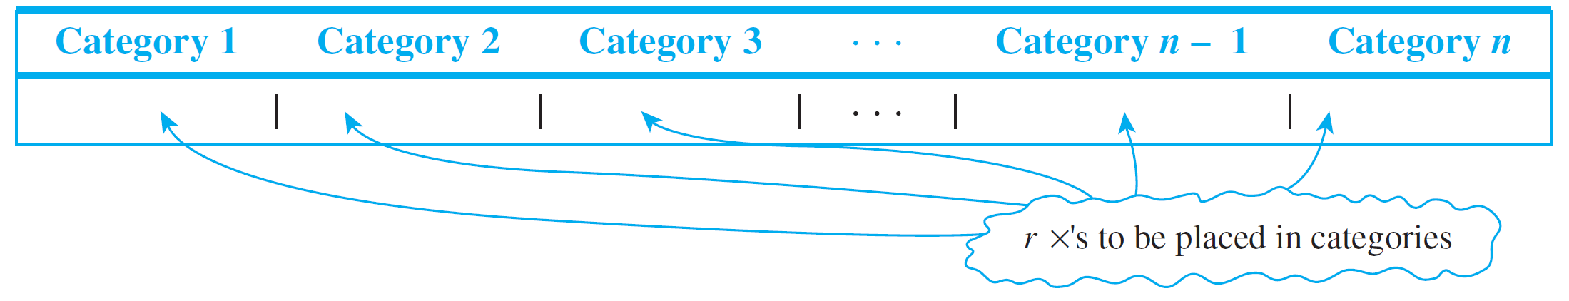
r-Combinations with Repetition Allowed
The number of strings of n – 1 vertical bars and r crosses is the number of ways to choose r positions, into which to place the r crosses, out of a total of r + (n – 1) positions, leaving the remaining positions for the vertical bars.

Slide 8
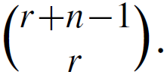
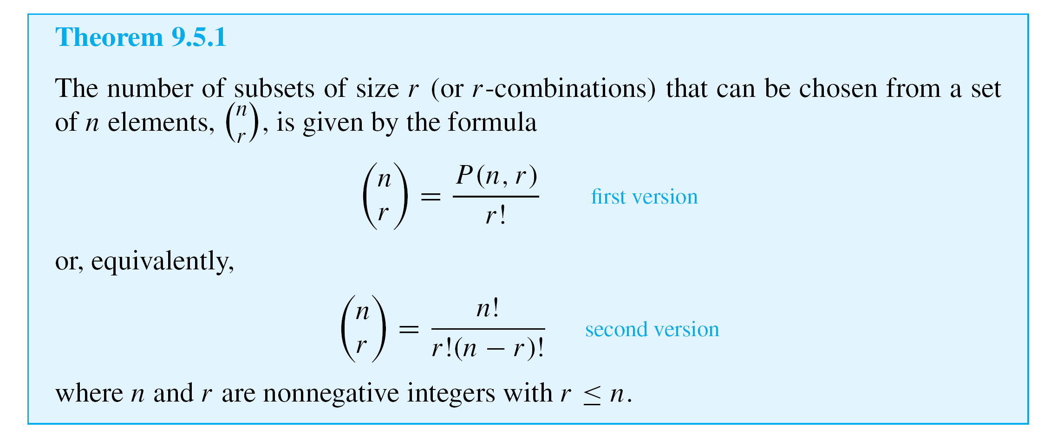
r-Combinations with Repetition Allowed
But by Theorem 9.5.1, this number is

Slide 9
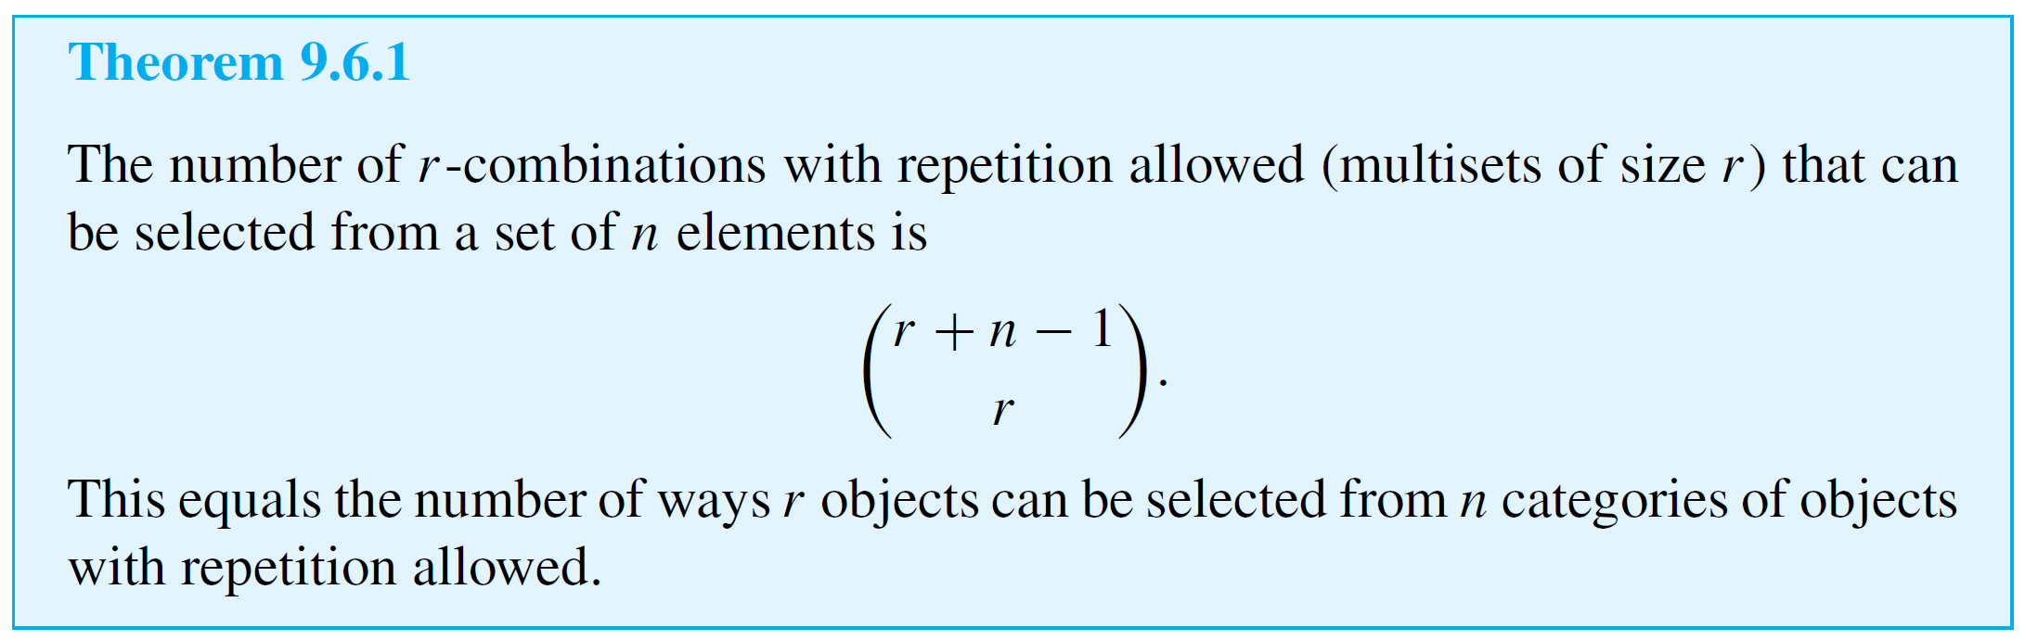
r-Combinations with Repetition Allowed
This discussion proves the following theorem.

Slide 10
Example 3 – Counting Triples (i, j, k) with 1 ≤ i ≤ j ≤ k ≤ n
If n is a positive integer, how many triples of integers from 1 through n can be formed in which the elements of the triple are written in increasing order but are not necessarily distinct? In other words, how many triples of integers (i, j, k) are there with 1 ≤ i ≤ j ≤ k ≤ n?
Solution:
Any triple of integers (i, j, k) with 1 ≤ i ≤ j ≤ k ≤ n can be represented as a string of n – 1 vertical bars and three crosses, with the positions of the crosses indicating which three integers from 1 to n are included in the triple.

Slide 11
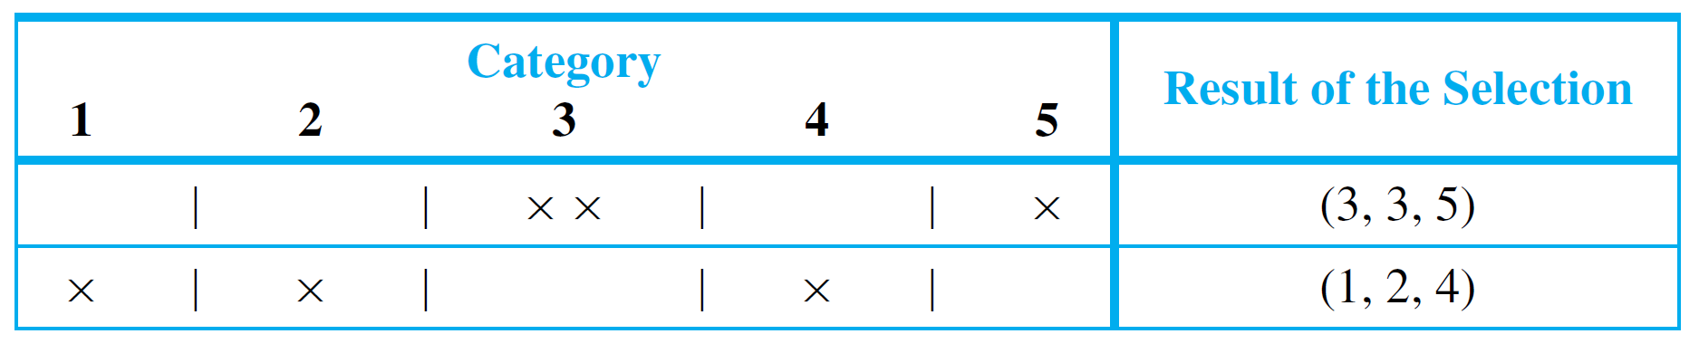
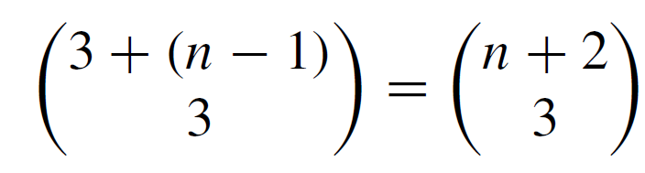
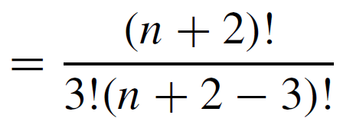
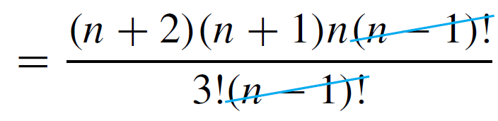
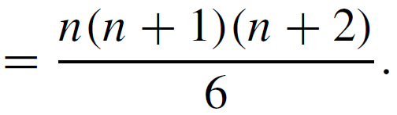
Example 3 – Solution
cont’d
The table below illustrates this for n = 5.
Thus the number of such triples is the same as the number of strings of (n – 1) |’s and 3 ×’s, which is

Slide 12
r-Combinations with Repetition Allowed
For instance, in Example 3 we might observe that there are exactly as many triples of integers (i, j, k) with
1 ≤ i ≤ j ≤ k ≤ n as there are 3-combinations of integers from 1 through n with repetition allowed because the elements of any such 3-combination can be written in increasing order in only one way.

Slide 13
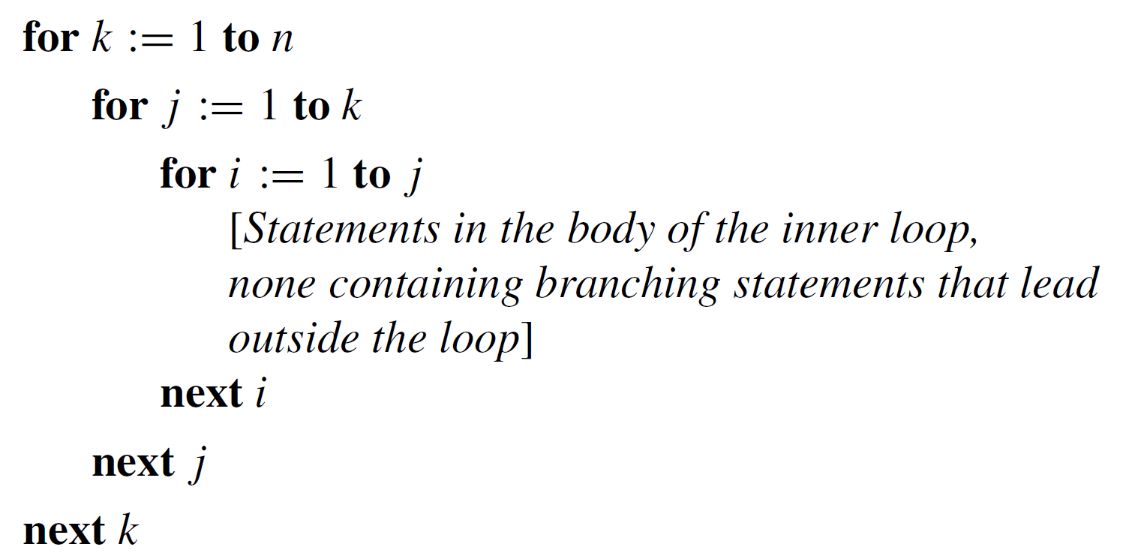
Example 4 – Counting Iterations of a Loop
How many times will the innermost loop be iterated when the algorithm segment below is implemented and run? (Assume n is a positive integer.)

Slide 14
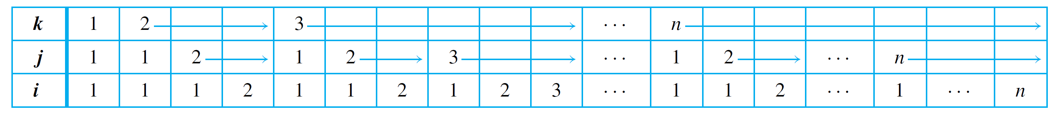
Example 4 – Solution
Construct a trace table for the values of k, j, and i for which the statements in the body of the innermost loop are executed. (See the table that follows.) Because i goes from 1 to j, it is always the case that i ≤ j.
Similarly, because j goes from 1 to k, it is always the case that j ≤ k.
To focus on the details of the table construction, consider what happens when k = 3. In this case, j takes each value 1, 2, and 3.

Slide 15
Example 4 – Solution
cont’d
When j = 1, i can only take the value 1 (because i ≤ j). When j = 2, i takes each value 1 and 2 (again because i ≤ j). When j = 3, i takes each value 1, 2, and 3 (yet again because i ≤ j).
Observe that there is one iteration of the innermost loop for each column of this table, and there is one column of the table for each triple of integers (i, j, k) with 1 ≤ i ≤ j ≤ k ≤ n.
But Example 3 showed that the number of such triples is [n(n + 1)(n + 2)]/6. Thus there are [n(n + 1)(n + 2)]/6 iterations of the innermost loop.

Slide 16
r-Combinations with Repetition Allowed
The solution in Example 4 is the most elegant and generalizable one.

Slide 17
Which Formula to Use?

Slide 18
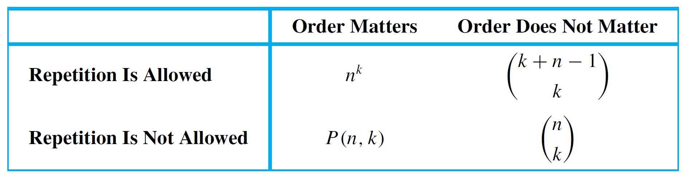
Which Formula to Use?
Earlier we have discussed four different ways of choosing k elements from n. The order in which the choices are made may or may not matter, and repetition may or may not be allowed. The following table summarizes which formula to use in which situation.

